Slide 1
CLASSIFYING ARTISTIC STYLES
Ana Petronijevic

Slide 2
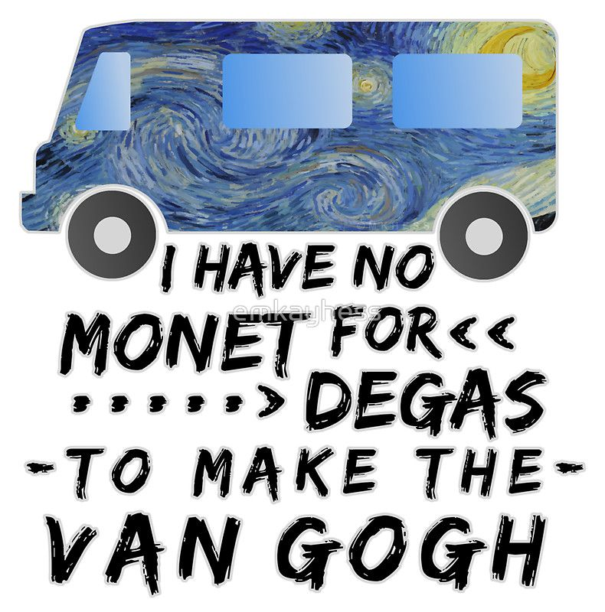

Slide 3
INTRODUCTION
01
MODELING
02
ANALYSIS
03
CONCLUSION
04
Impressionism & Romanticism
Image preprocessing & CNN
Predictions and analyzing RGB values
How to make improvements

Slide 4
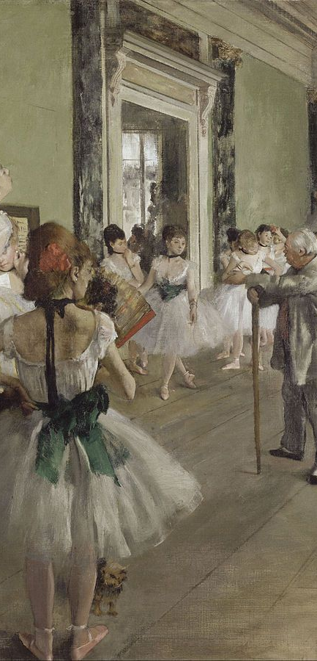
IMPRESSONISM
Name from Claude Monet’s Impression, Sunrise 1847.
Critic Louis Leroy felt the painting was unfinished, or an “impression”.
Displayed shadows and highlights in color, loose brush work
This gave an effortless and spontaneous effect
Suburban Paris, rural leisure were popular subjects (most notably win Monet and Pierre-Auguste Renoir)
Practice of painting landscapes, scenes of everyday life and spontaneously on the spot
Developed in France in the 19th century

Slide 5
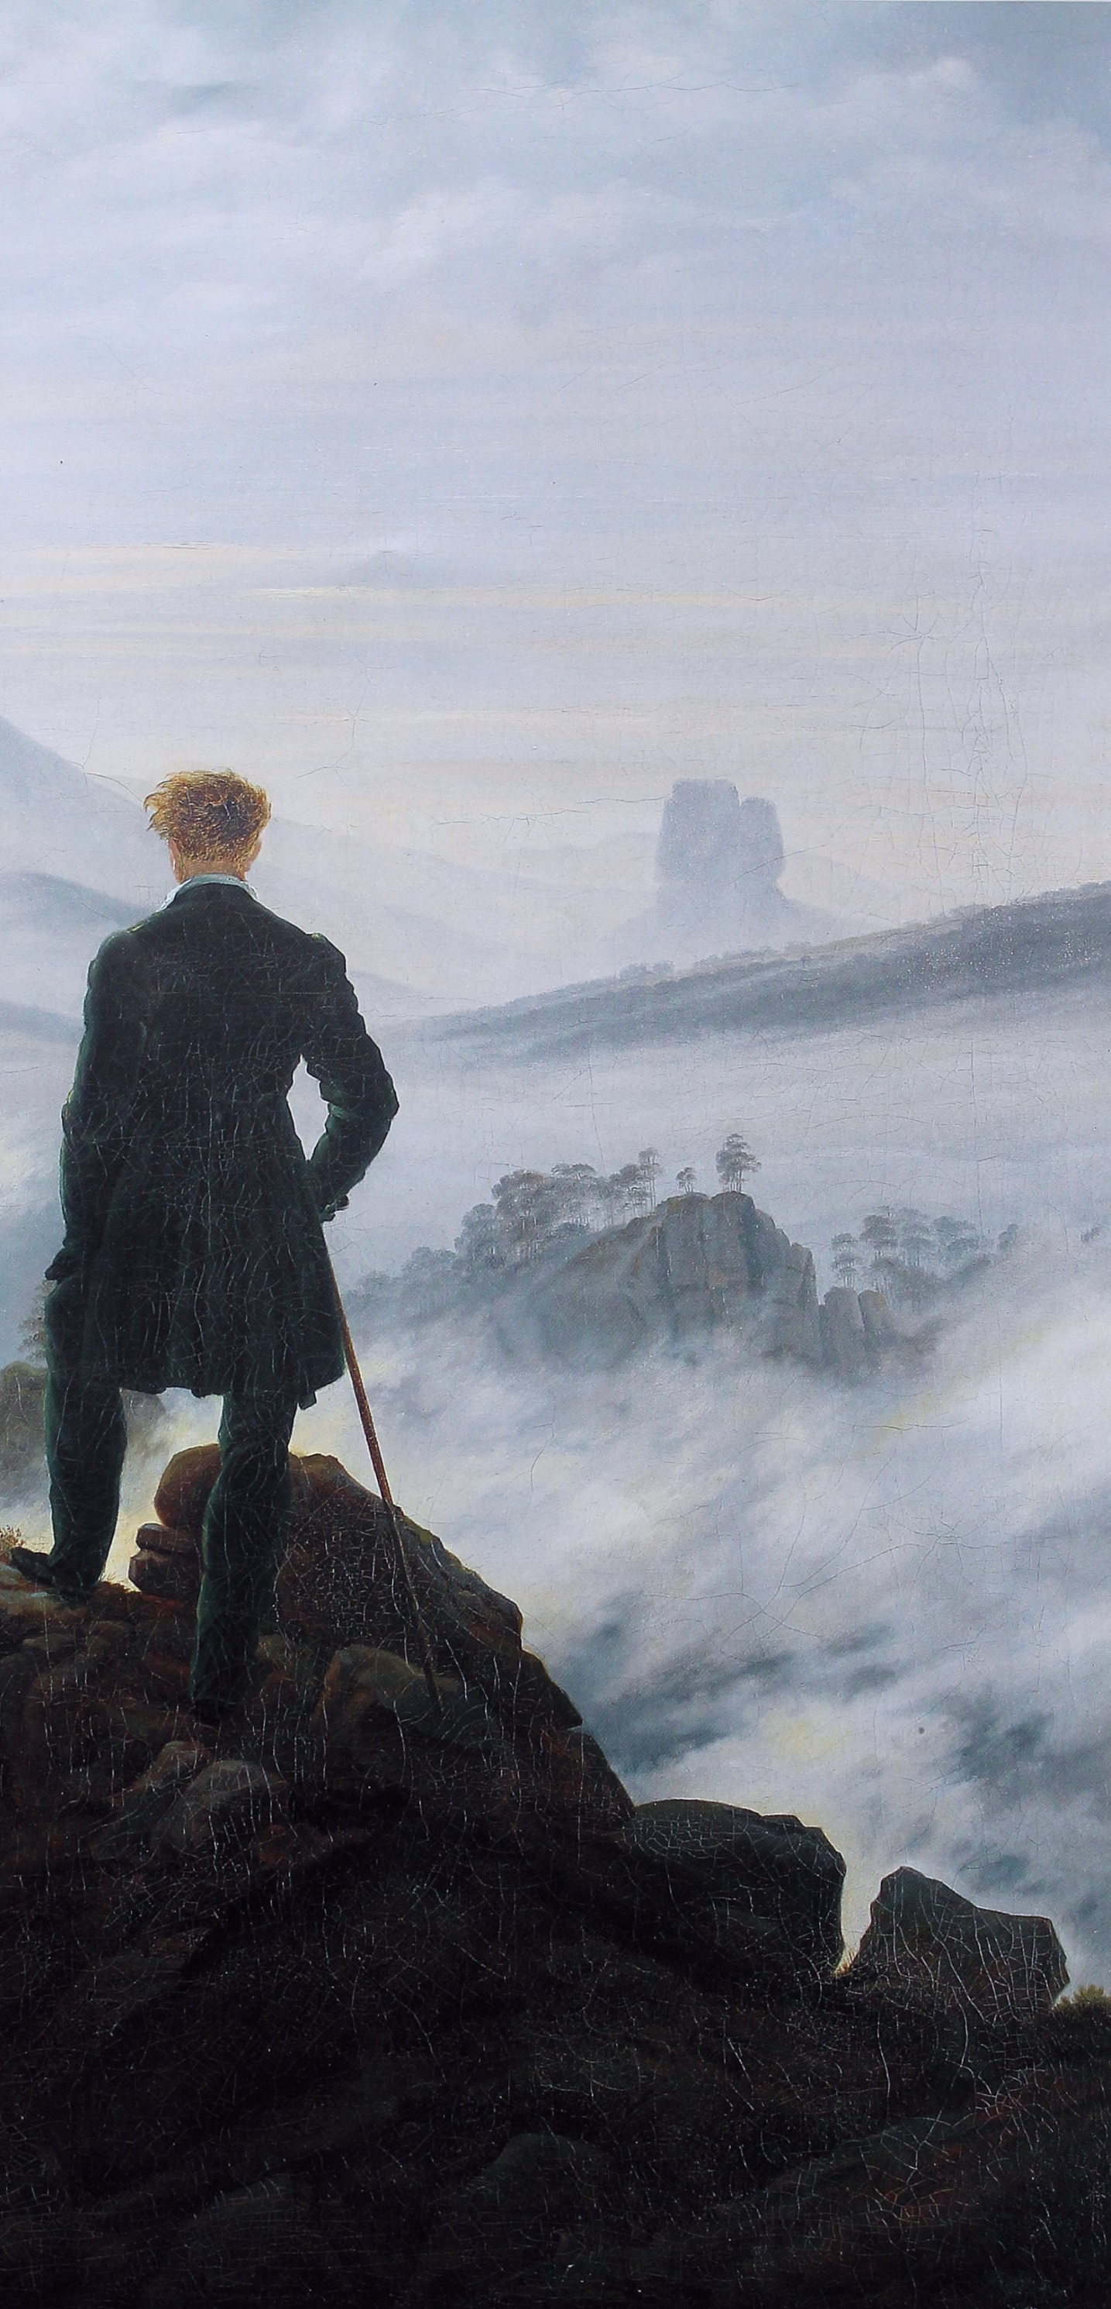
ROMANTICISM
First defined as an aesthetic in literary criticism.
Gained moment as an artistic movement in France and Britain in early decades of 19th century.
Emphasis on imagination and emotion in contrast to classical restraint.
Distinguished by a new interest in human psychology, expression of personal feeling and interest in the natural world. – Tate Museum
Subject matter varied widely: landscapes, religion, revolution, peaceful beauty.
“the artist’s feeling is his law”- Caspar David Freidrich
Brushwork became looser and less precise.

Slide 6
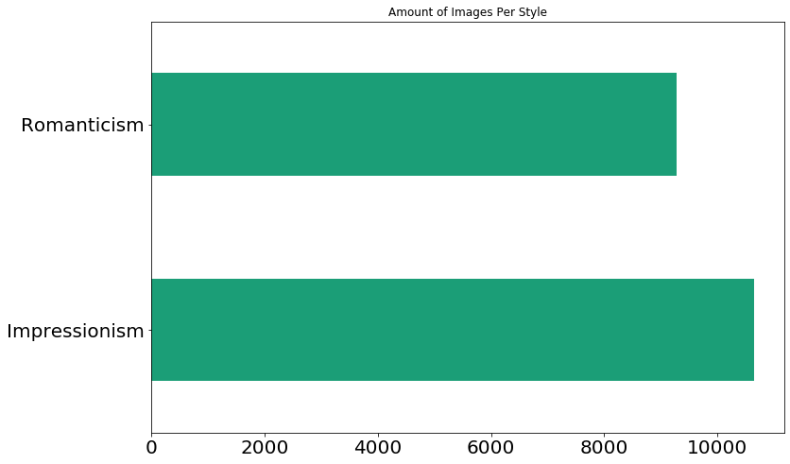
THE DATA:
Amount of Images Per Style
Data: From Kaggle’s painters by numbers.
Positive class: Romanticism

Slide 7
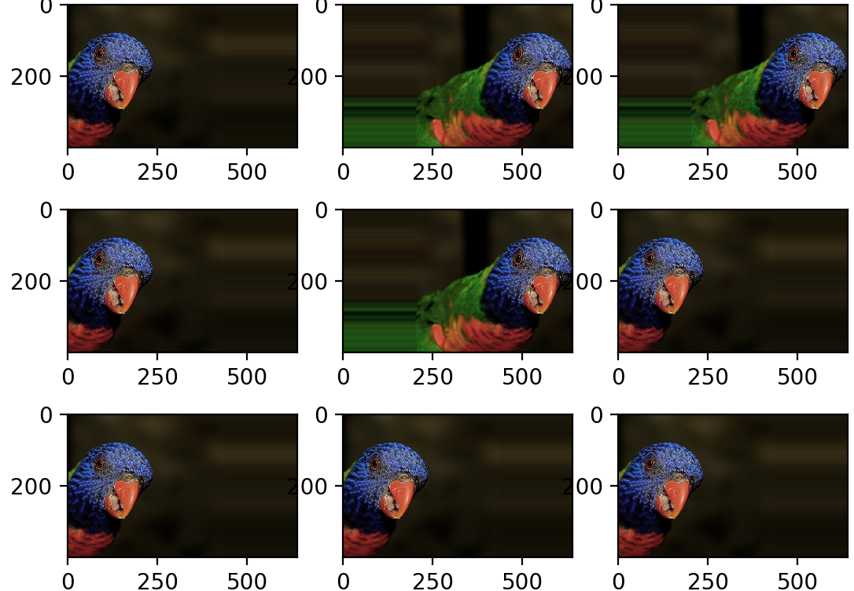
IMAGE PREPROCESSING AND AUGMENTATION
ImageDataGenerator(rescale=1./255, rotation_range=20, width_shift_range=0.2, height_shift_range=0.2, horizontal_flip=True, channel_shift_range=100, brightness_range=(0.2, 1.5), validation_split=0.25)

Slide 8
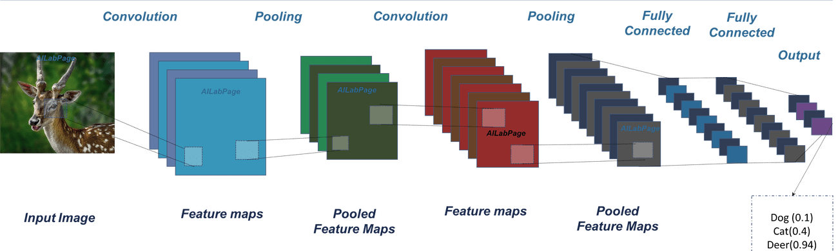
CONVOLUTIONAL NEURAL NETWORK

Slide 9
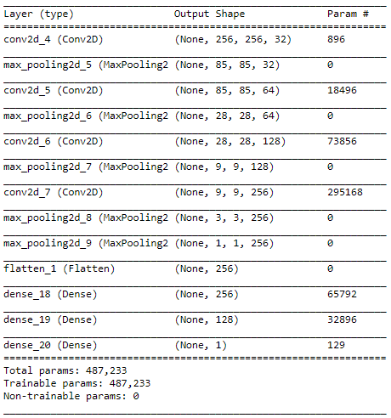
CNN MODEL

Slide 10
ACCURACY SCORE
78.86%
Testing Accuracy
Training Accuracy
78.88%

Slide 11

CONFUSION MATRIX
True Negatives
False Positives
1896
964
False Negatives
True Positives
1383
739

Slide 12
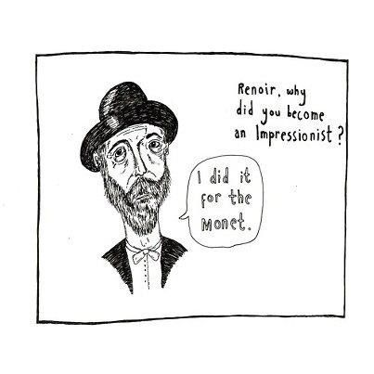

Slide 13
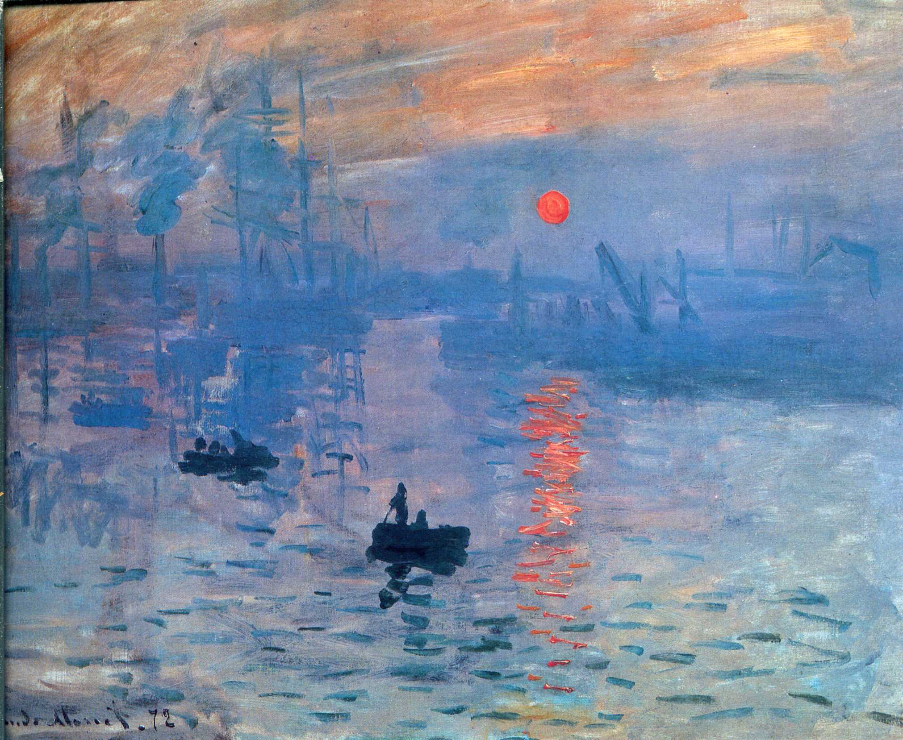
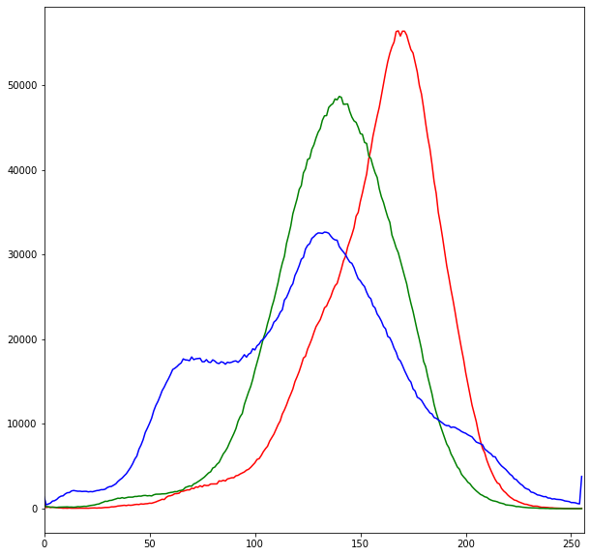
PREDICTIONS
Actual: Impressonism Predicted: Romanticism
Color Channels Intensity Distribution
Pixel Count
Monet
Impression, Sunrise
1872
Image where the term impressionism came from.
Color Value: RGB

Slide 14
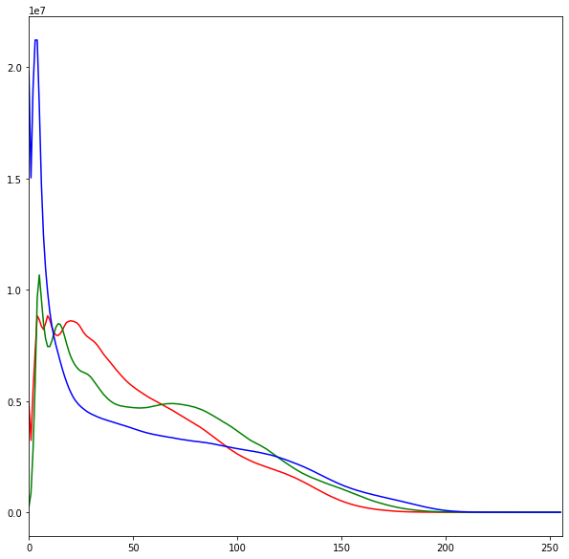
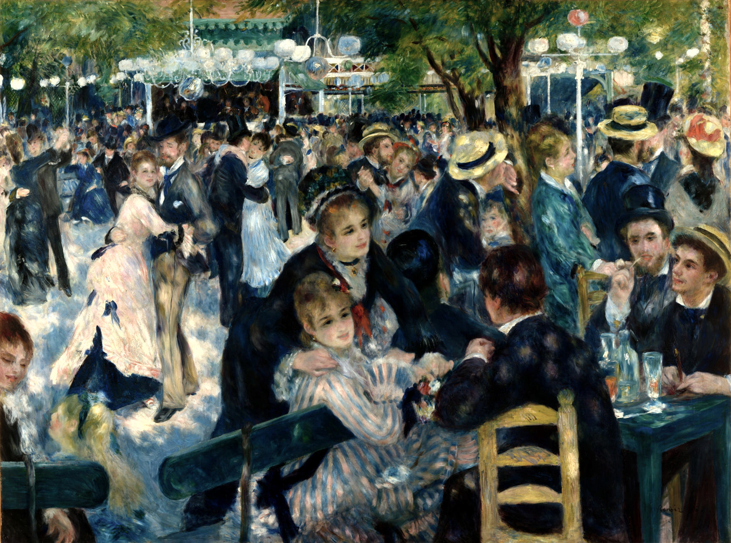
PREDICTIONS
Actual: Impressonism Predicted: Romanticism
Color Channels Intensity Distribution
Pixel Count
Renoir
Bal du moulin de la Galette (commonly known as Dance at Le moulin de la Galette)
1876
Color Value: RGB

Slide 15
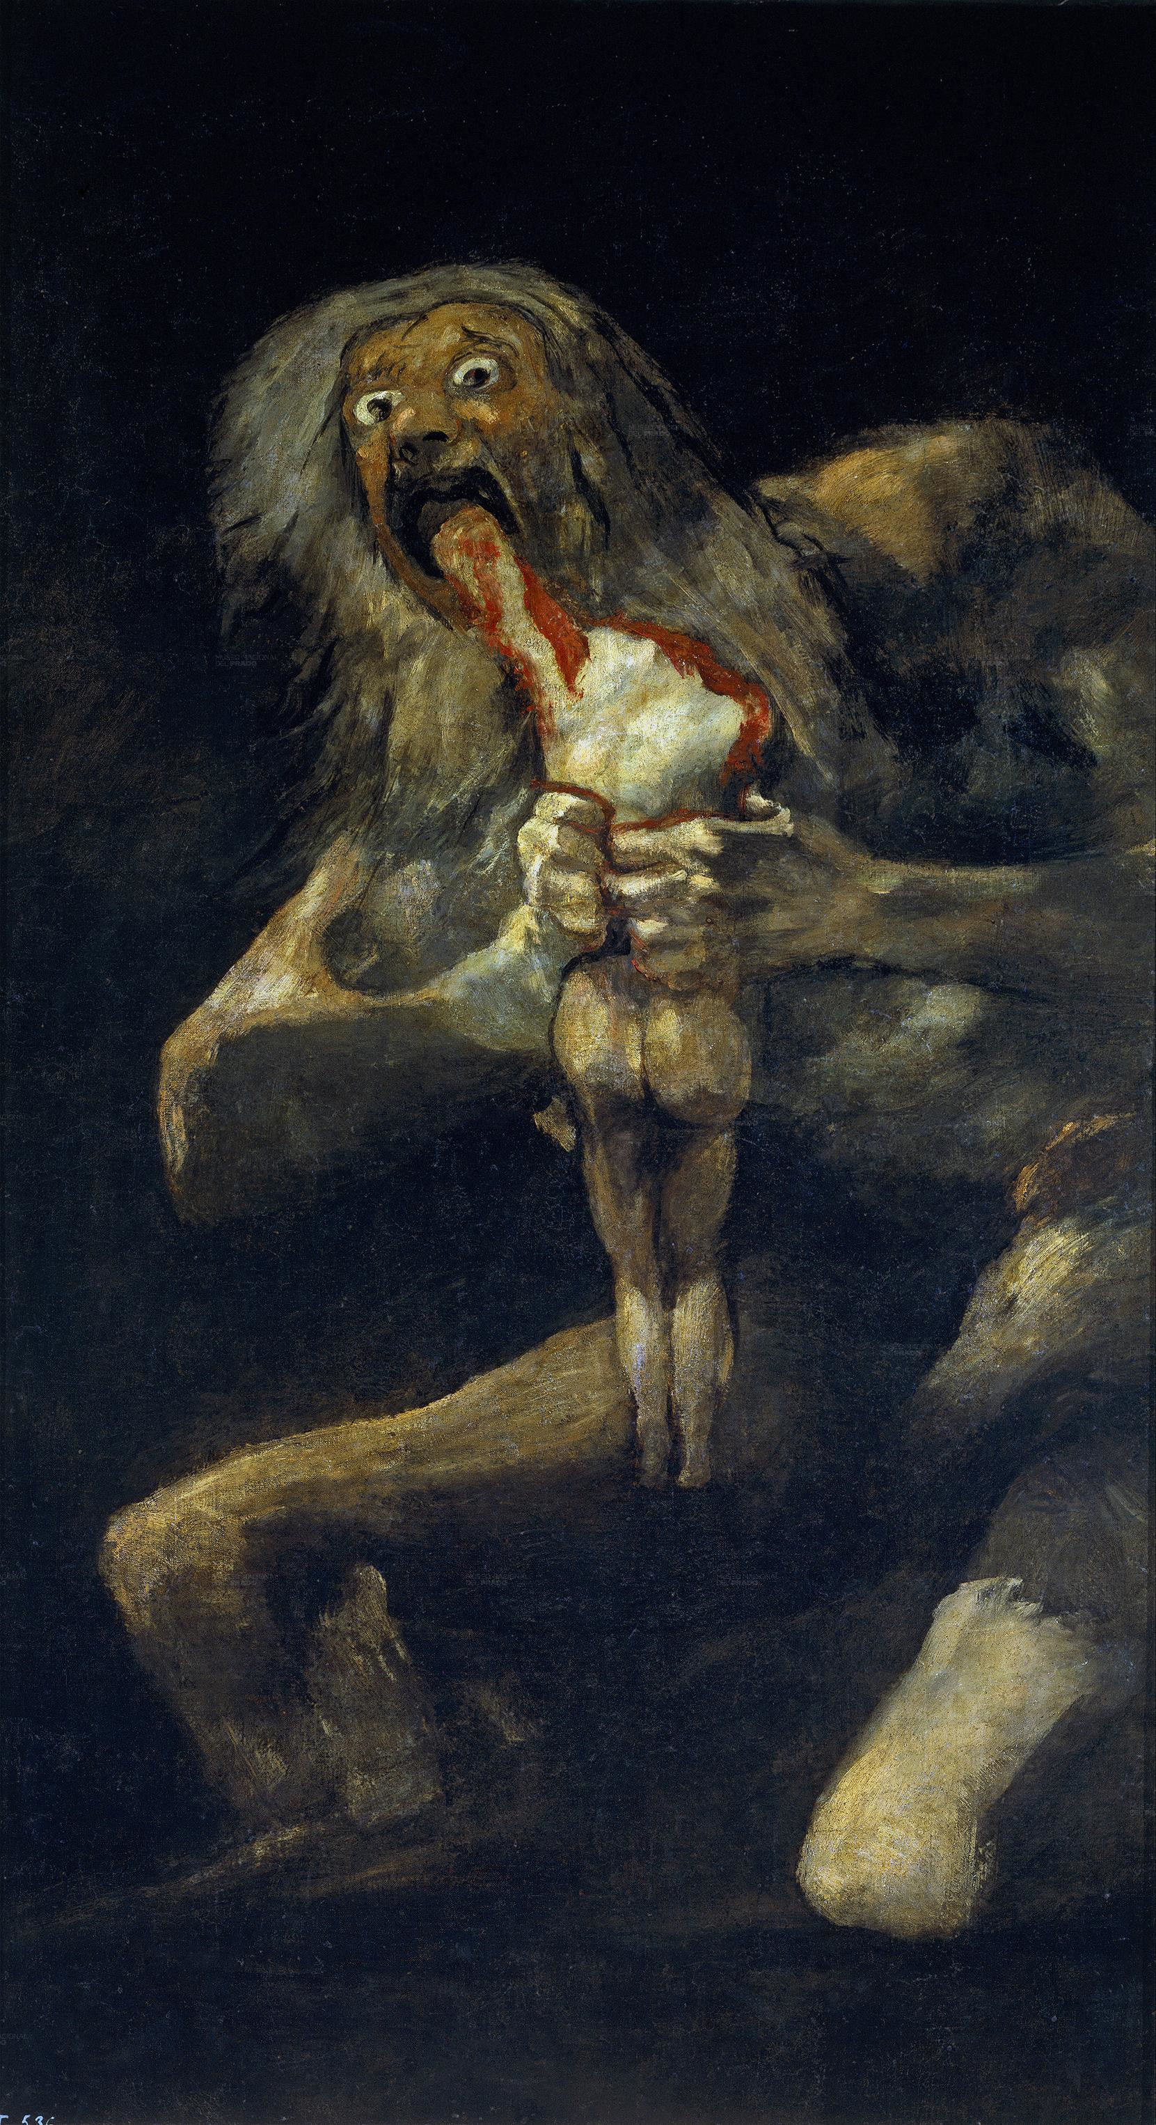
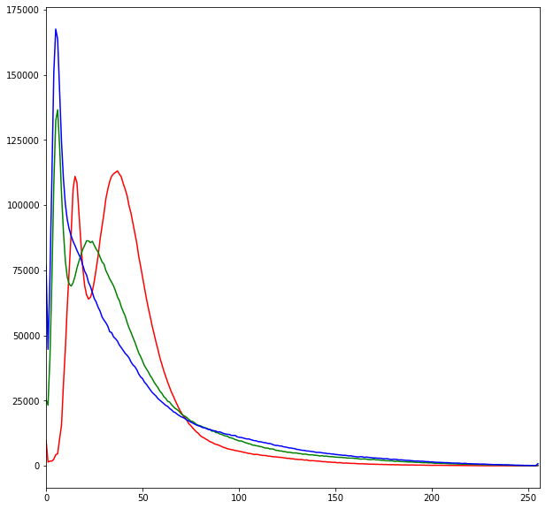
PREDICTIONS
Actual: Romanticism Predicted: Romanticism
Color Channels Intensity Distribution
Pixel Count
Goya
Saturn Devouring His Son
1819-1823
Color Value: RGB

Slide 16
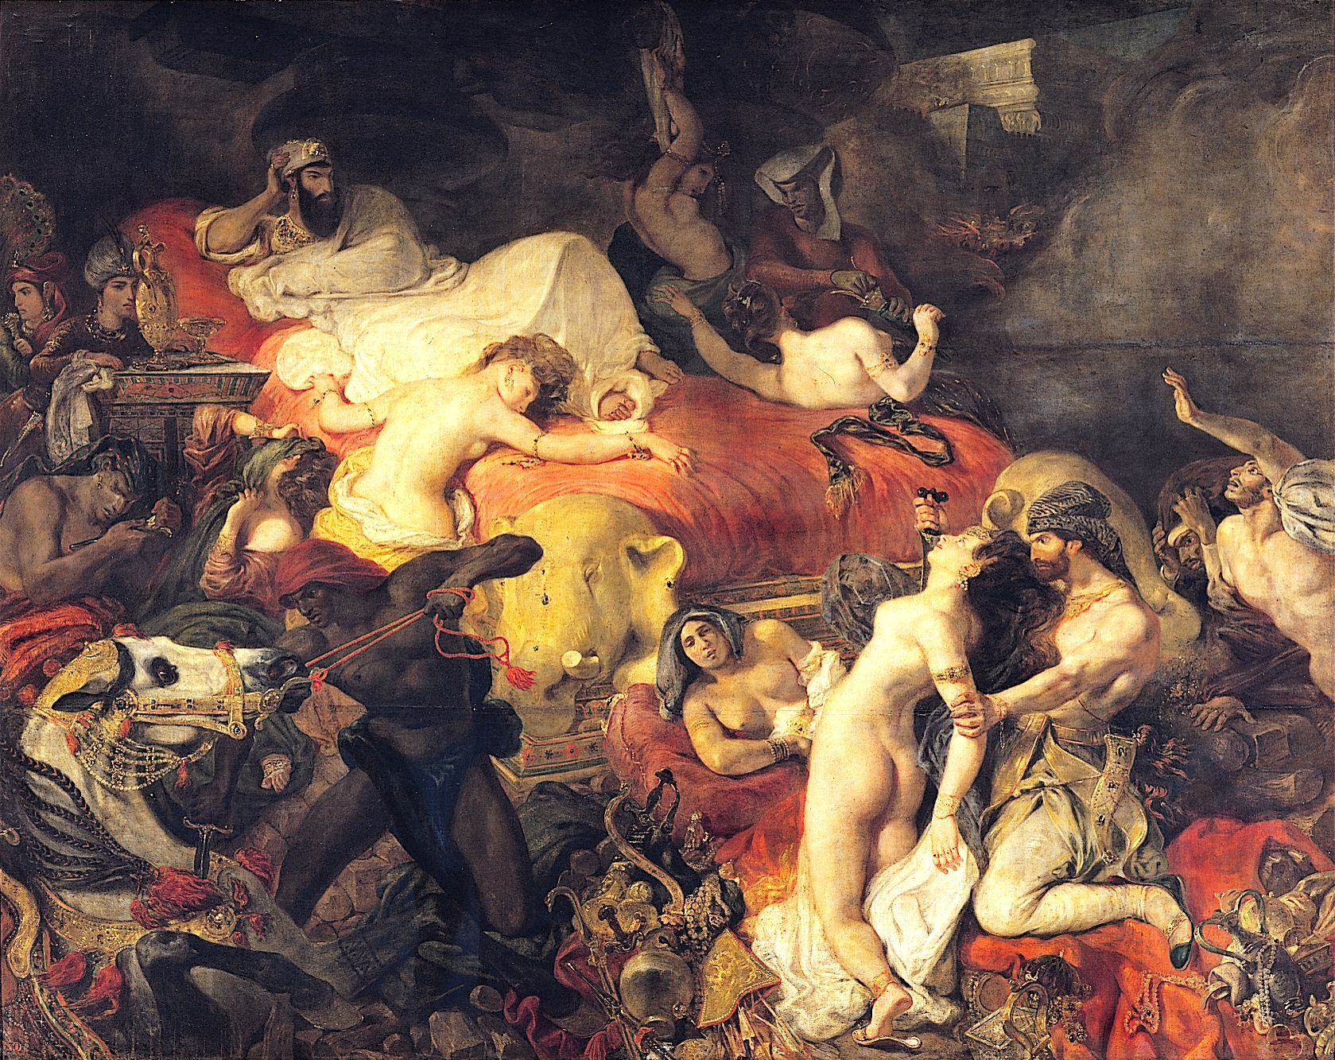
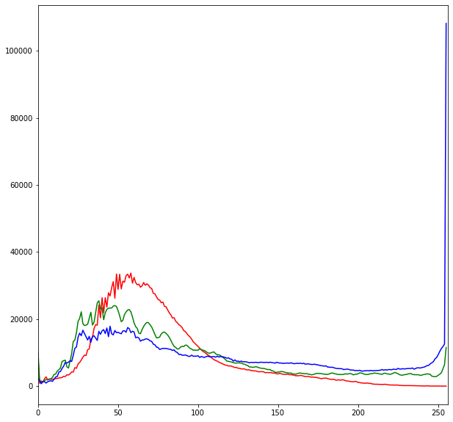
PREDICTIONS
Actual: Romanticism Predicted: Impressonism
Color Channels Intensity Distribution
Pixel Count
Renoir
Bal du moulin de la Galette (commonly known as Dance at Le moulin de la Galette)
1876
Color Value: RGB

Slide 17
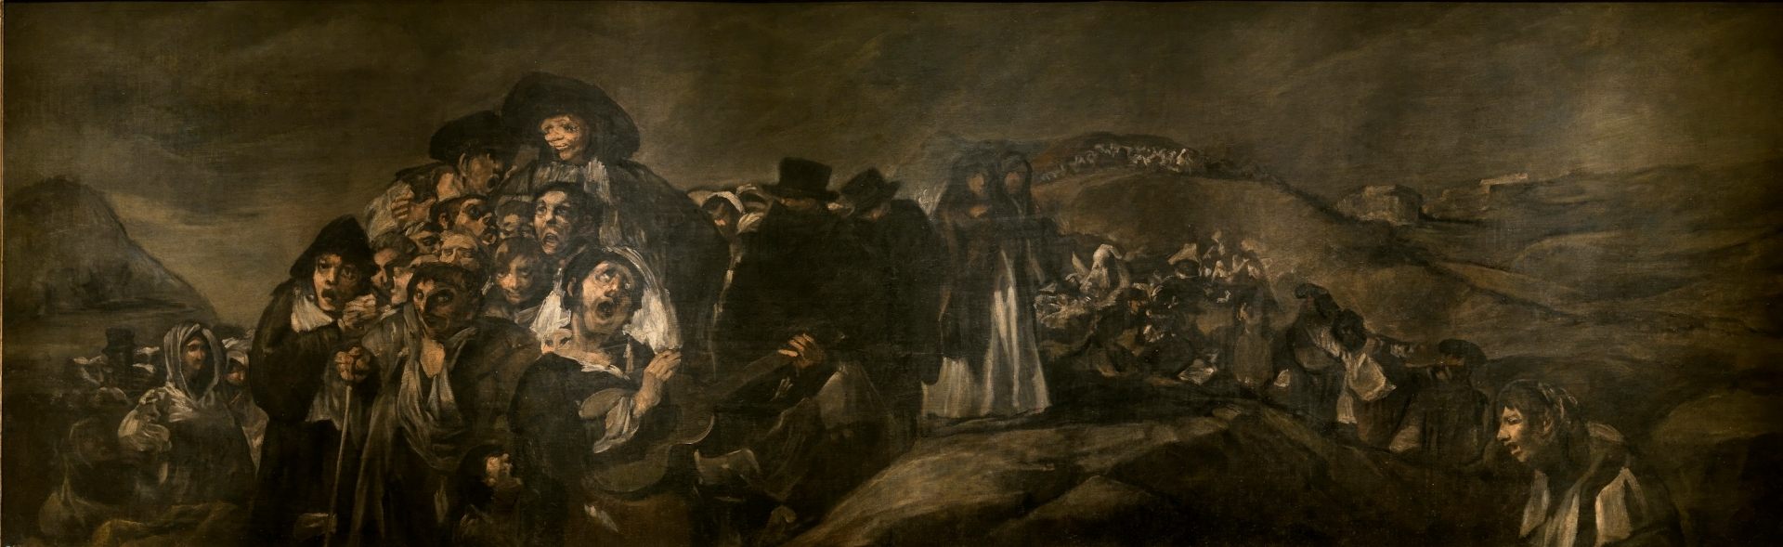
CONCLUSIONS:
Use localization/object detection to find common subject matter and how that might affect predictions.
For example, an impressionist portrait was in accurately predicted. Portrait are not common in impressionism.
Train sketches and artist separately and use transfer learning.
Paintings at the beginning and end of certain period might have influences of a prior or changing style.
Higher quality images
Monet painted many images of the same location at different times and analyzing how pixel values can change the prediction.
More data. Scrapping museums, websites of artist, institutions.
Use a cloud platform to train a stronger model.

Slide 18
THANKS!
Do you have any questions?
anapetronijevic56@gmail.com
Please keep this slide for attribution

Slide 19
RESOURCES
https://vinodsblog.com/2018/10/15/everything-you-need-to-know-about-convolutional-neural-networks/
https://www.tate.org.uk/art/art-terms/r/romanticismdesk
https://www.tate.org.uk/art/art-terms/i/impressionism
https://www.metmuseum.org/toah/hd/imml/hd_imml.htm
https://www.metmuseum.org/toah/hd/roma/hd_roma.htm

